Slide 1
Structural Bioinformatics

Slide 2
Structural Bioinformatics
Structural Bioinformatics is an interdisciplinary field that deals with the three dimensional structures of biomolecules.
It attempts to model and discover the basic principles underlying biological machinery at the molecular level.
It is based on the assumption that 3D structural information of a biological system is the core to understanding its mechanism of action and function.
Structural bioinformatics combines applications of physical and chemical principles with algorithms from computational science.

Slide 3
Major areas:
protein and nucleic acid 3D structure determination
prediction of protein 3D structure from sequence
protein structure validation
protein structure comparison and alignment
protein and nucleic acid structure classification
inferring protein function from structure
prediction of protein-ligand interaction
prediction of protein-protein interactions
development of databases

Slide 4
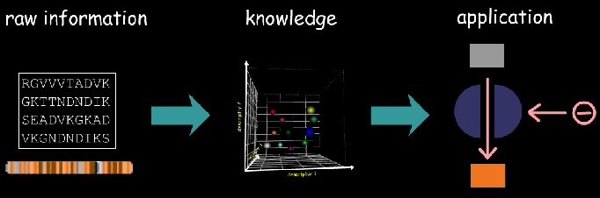
Challenges in the Post Genomic era
The completion of HGP (first draft 2002 and completion in 2003) and other genome projects were the first step towards the comprehensive understanding of life at molecular level.
One of the key issues is the characterization of structure and function of proteins with a view to using the findings in the discovery if novel drugs and therapeutic treatments.

Slide 5
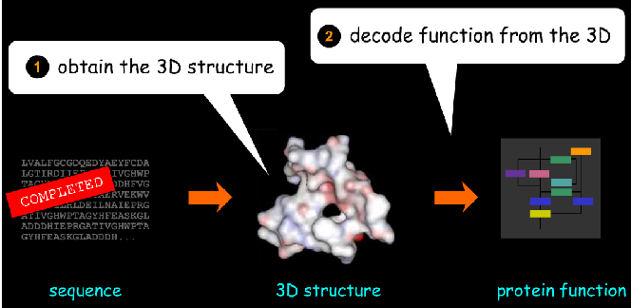
Structure-function paradigm
Structural bioinformatics is based on protein structure-function paradigm, which states that the function of a molecule is dictated by its 3d structure.
The challenges for post genomic era:
  Obtain the 3D structure of all proteins encoded in the genomes.
  Decode their function based on its structure

Slide 6
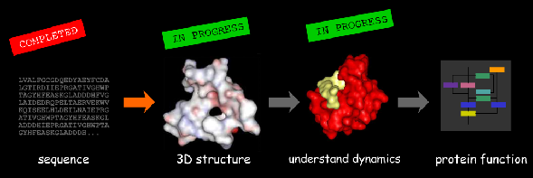
Is structure Sufficient to Predict Function
Proteins are not static; to fulfil their function they undergo wide range of motion and conformational rearrangements.
An important component of SBI is development of experimental and computational methods (dynamics) that sheds the lights on the behavior of biological systems.

Slide 7
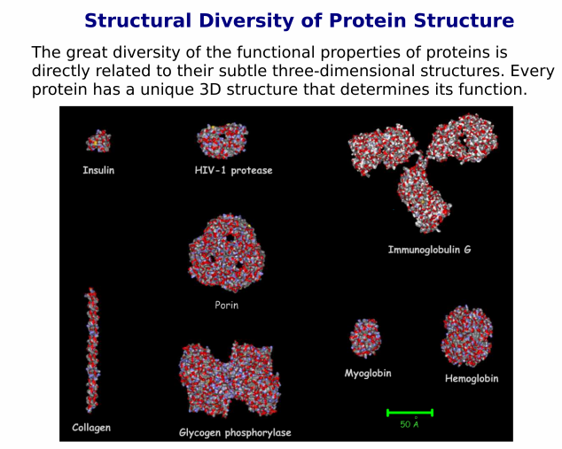

Slide 8
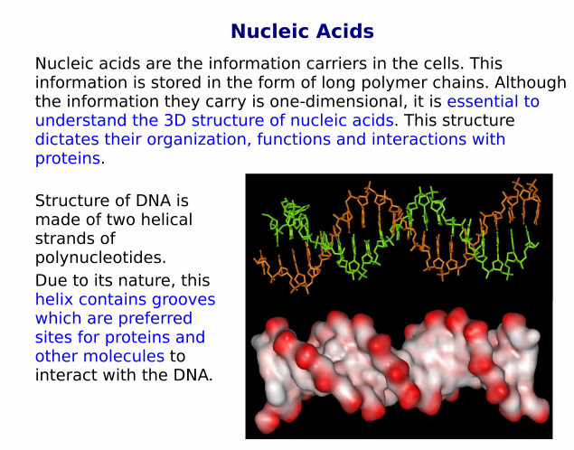

Slide 9
Protein 3D Structure and Classification Database

Slide 10
Introduction
Protein data bank is an archive of experimentally determined 3D structures of biological macromolecules.
It was established in 1971 by Research Collaboratory for Structural Bioinformatics (RCSB) (Brookhaven Laboratories, USA)
It is a single worldwide repository for structures of biological macromolecules.
It aims towards the efficient collection and curation of data.
It maintains an organized system- integrating the steps of data deposition, annotation and validation. There are many awaiting release- called unreleased entries and information is given separately.

Slide 11
History of PDB
The worldwide protein data bank (www.wwPDB.org) was established in 2003.
RCSB, Macromolecular Structure Database (MSD), European Bioinformatics Institute (EBI), Protein Databank of Japan (PDBJ), Institute for Protein Research, Osaka University were the founding members of the Data bank.
Proper guidelines has been made for the distribution data, maintain a single PDB archive of macromolecular structural data which should be available to global scientific community.

Slide 12
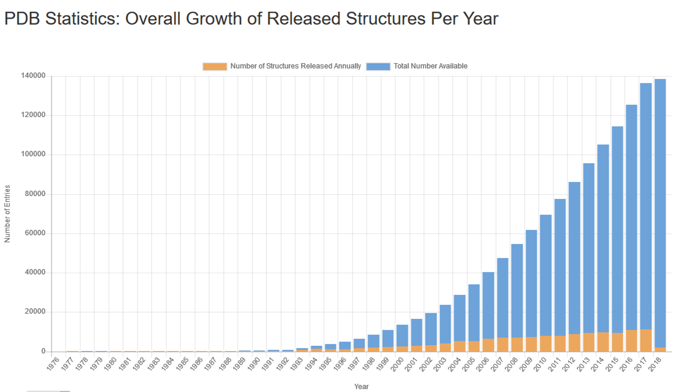

Slide 13
Download a structure file
The structure files obtained from experimental methods such as NMR,X-ray crystallography, etc., can be downloaded form WWW or from FTP site.
Multiple sites can also be retrieved using multiple PDB Ids separated by commas or spaces.
The structure download page helps to download in three formats- PDB format, mace format and PDBML/XML format.
One can choose to download a file or multiple files either uncompressed files or zip files to reduce the size of the files.

Slide 14
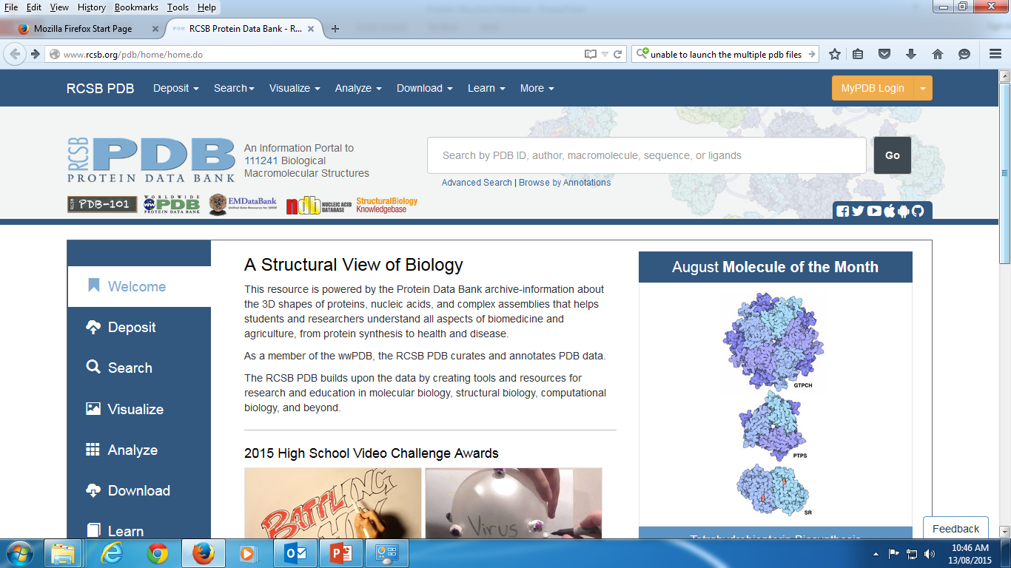

Slide 15
Data Deposition Tools
Auto Dep Input Tool (ADIT)
  Developed by RCSB
  Provides the checking of the format of the coordinate, structure factor file, and performs validation tests on deposition in the database.
  ADIT facilitates the incorporation of any additional information during the process.
pdb_extract
  Online tool which aims to reduce the manual labour needed to assemble the statistical information from the output files generated during the protein structure deamination using X-ray or NMR methods.
  It generates two mmCIF (macromolecular Crystallographic Information) where all the coordinates are merged.
  One file contains structure factor and other file contains atomic coordinate and these two files serve as PDB deposition
Ligand Depot
  Serves as a data resource which integrates information related to small molecules bound to macromolecules. It includes the chemical and structural information
Validation server
  Provides the opportunity of checking the format of coordinate and structure factor files with help of RCSB.
  Two operators - Pre-check and validate. (PDB or mmCIF)
  The report contains the summary information, including bond distance, angle comparison, molecular images.

Slide 16
Data which includes atomic coordinators, structure factors, and NMR restraints are further processed by pdb_extract to prepare two files (mmCIF).
Structure is validating using validation server ADIT
Immediately after depositing a structure is deposited using ADIT, a PDB identifier is sent to author automatically and structure is loaded in the internal-core database.
Entry is annotated and process involved ADIT to help diagnose errors or any inconsistence in the files.
  The completely annotated entry, as it will appear in the PDB resource, together with validating information is sent back to depositor.
  After review, authors send revisions if any.
  Depending on the nature of revision first two steps will be repeated.
  Once approval is received from the author, the entry and the tables in the internal-core database is ready for distribution.

Slide 17
Molecular modelling Databases MMDB
There are two databases of NCBI
  Molecular modelling database
  Conserved domain database
MMDB is the revised version of PDB structures- containing experimentally determined bimolecular structures obtained from PDB.
CCD provides a directory of sequence and structure alignments representing conserved functional domains with in the proteins.
Common points:
  To retrieve and view structure
  To find the structurally similar proteins to a protein of interest
  Identify the conserved functional sites

Slide 18
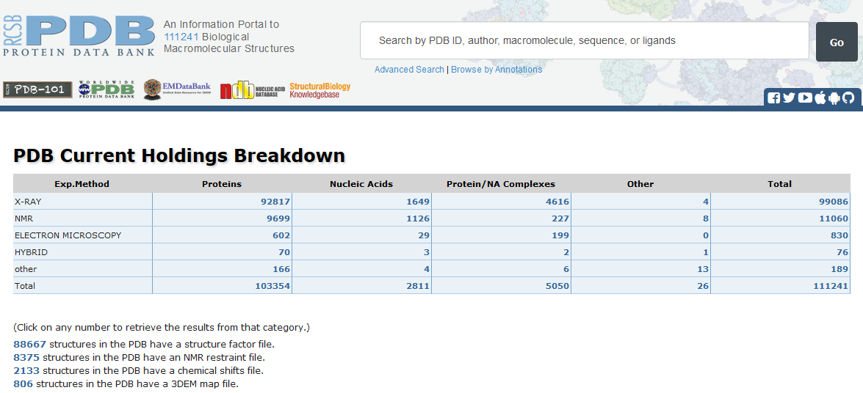

Slide 19
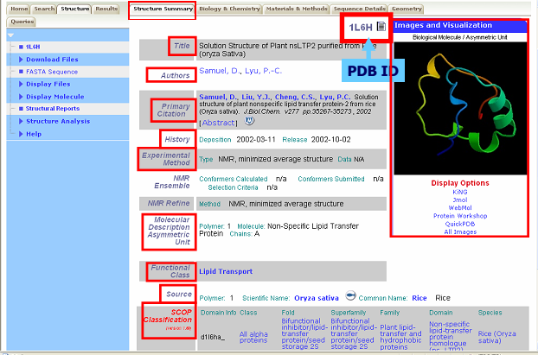

Slide 20
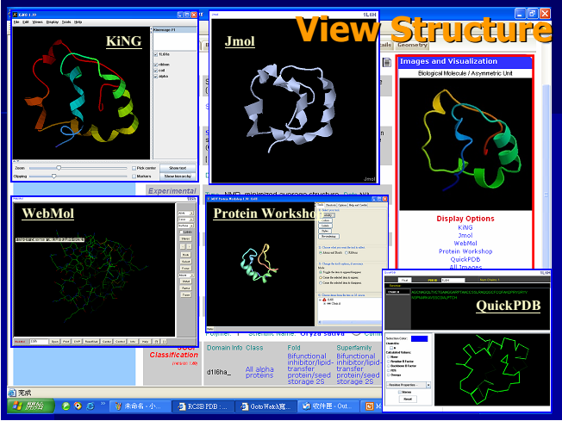

Slide 21
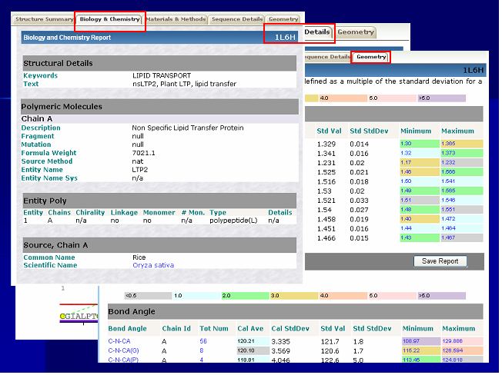

Slide 22
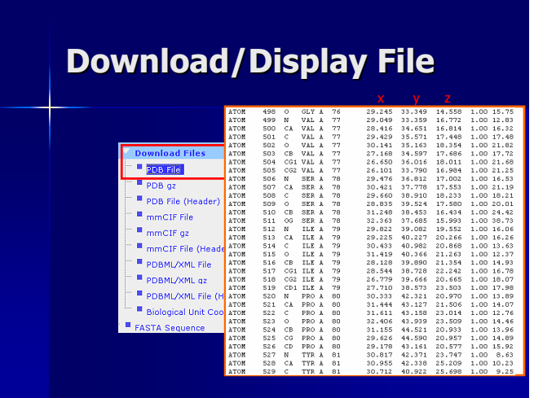

Slide 23
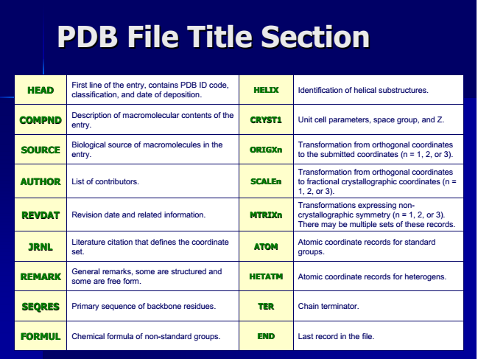

Slide 24
Protein structure classification database
Classify proteins based on their structure.
Helps in different ways like building a model of the proteins based on their structural similarity.
The reasons for such classification are:
  The number of solved structures are growing rapidly
  This helps to detect similarities (evolutionary relation ships)
  This can aid in building a model of a protein based on the proteins from the same class.
  This can help in setting up prediction benchmarks.

Slide 25
CATH- CLASS, ARCHITECTURE, TOPOLOGY, HOMOLOGOUS
It is hierarchical domain classification of protein structures in the Brookhaven PBD.
Crystal structures of resolution better than 3.0 A⁰ are only considered along with NMR structures.

Slide 26
Structure comparison: sequential structure alignment program (SSAP) and manual
Domain separated using programs and human expert
Class in CATH similar to SCOP
Architecture is unique to CATH – describes overall packing and arrangement of secondary structures independent of connectivity between the elements
Topology equivalent to fold in SCOP – describes overall orientation of secondary structures and sequence connectivity between secondary structure elements
Homologous superfamily and homologous family equivalent to superfamily and family levels in SCOP

Slide 27
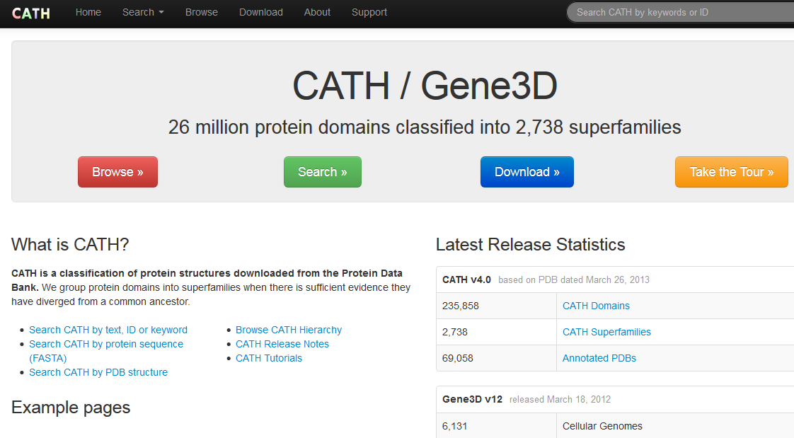

Slide 28
Class, C-level (automated)
Class is determined according to the secondary structure composition and packing with in the structure.
It can be assigned automatically for over 90% of the known structures
For the remainder, manual inspection is used and necessary information from the literature is taken into account.
Major classification
Mainly - alpha
Mainly - beta
alpha-beta

Slide 29
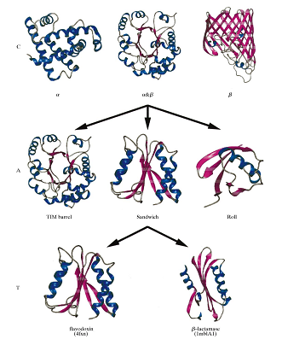
Schematic representation of
the (C)lass, (A)rchitecture and
(T)opology/fold levels in the
CATH database.

Slide 30
Architecture, A level (manual)
This describes the overall shape of the domain structure as determined by the orientations of the secondary structures
It is currently assigned manually using a simple description of the secondary structure arrangement. E.g. barrel or a three-layer sandwich

Slide 31
Topology (fold family), T-level (semi-automated)
Structures are grouped into the fold families at this level depending on both the overall shape and connectivity of the secondary structures.
This is done using the structures comparison algorithm SSAP.
Parameters for clustering the domains into the same fold family have been determined by trials throughout the databanks.
Structures which have a SSAP score of 70 and where at least 60% of the larger protein matches the smaller protein are assigned to the same T level fold family

Slide 32
Homologous Superfamily, H-level (semi-automated)
At the H-level, structures are grouped by their high structural similarities and similar functions.
This suggests that they may have evolved from a common ancestor, particularity where there are resemblances in the core-packing or putative-active sites.
This is equivalent to super family in the SCOP database.

Slide 33
Sequence families, S -level
Structure within each H-level are further clustered on the sequence identity.
Domains clustered in the same sequence families have sequence identities >35% (with at least 60% of the larger domain equivalent to the smaller), indicating higher similar structure and functions

Slide 34
SCOP – (Structural Classification of Proteins)
SCOP is a comprehensive database of all proteins of known structures, according to their evolutionary and structural relationship.
The main focus is conserved structural features (evolutionary framework)
Fundamental unit of classification in the SCOP database is the protein domain.

Slide 35
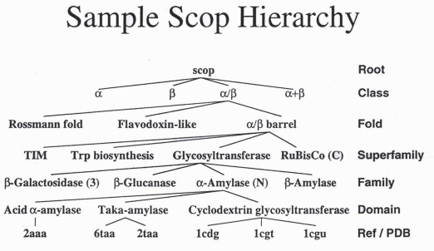

Slide 36
SCOP
Manual comparison by human experts
Hierarchical classification
Family > 30% sequence identity – close evolutionary relationship – normally same functionality
Superfamilies – similar structures – weak sequence similarity – share common ancestral origin – relationship between families distant
Folds – superfamilies' with common core structure – manual - similar overall secondary structures – similar orientation and connectivity - members of same fold do not always have evolutionary relationship
Classes – folds with similar core structures
Some classes based on general features; membrane proteins, small proteins, irregular proteins

Slide 37
Versions…
PDB

Slide 38
Version History
Version 2.3: The format in which structures were released from 1998 to July 2007.
Version 3.0: Major update from Version 2.3; incorporates all of the revisions used by the wwPDB to integrate uniformity and remediation data into a single set of archival data files including IUPAC nomenclature.
Version 3.1: Minor addenda to Version 3.0, introducing a small number of changes and extensions supporting the annotation practices adopted by the wwPDB beginning in August 2007 including chain ID standardization and biological assembly .
Version 3.15: Minor addenda to Version 3.20, introducing a small number of changes and extensions supporting the annotation practices adopted by the wwPDB beginning in October 2008 including DBREF, taxonomy and citation information.

Slide 39
Version 3.20: Minor addenda to Version 3.1, introducing a small number of changes and extensions supporting the annotation practices adopted by the wwPDB beginning in December 2008 including DBREF, taxonomy and citation information.
  September 15 2008, initial version 3.20.
  November 15 2008, add examples for Refmac template and coordinate with alternate conformation.
  December 24 2008, update REMARK 3 templates/examples, add Norine database in DBREF, update REMARK 500 on chiral center.
  February 12 2009, update example in REMARK 210 and record format in NUMMDL.
  July 6 2009, update description for REVDAT, DBREF2, MASTER and extend number of columns for AUTHOR, JRNL, CAVEAT, KEYWDS, etc.
  December 22, 2009, update CAVEAT and REMARK 265.

Slide 40
Version 3.20: continues….
  April 21, 2010, update REMARK 5 and add BUSTER-TNT template in REMARK 3.
  December 06, 2010, update maximum number of atoms for model. Update REMARK 3 with B value type for Refmac template.
  March 30, 2011, correct description and examples for FORMUL and CONECT records. Change template in REMARK 630.
Version 3.30: Current version, minor addenda to Version 3.2. , introducing a small number of changes and extensions supporting the annotation practices adopted by the wwPDB beginning in July 13 2011 including REMARK 0, REMARK 3, REMARK 400 and REMARK 630.
  July 13 2011, initial version 3.30.
  October 05, 2011, update REMARK 350 and OBSOLETE.
  May 09, 2012, update description in REMARK 470, HET, ATOM and MODEL.
  November 21, 2012, minor typo corrections.

